Slide 1
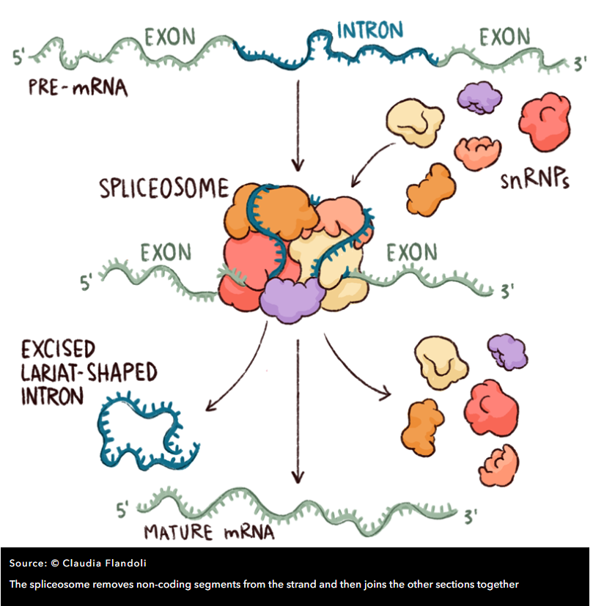
Splicing
Spliceosome includes five so-called ‘small nuclear ribonucleoproteins’ (snRNPs, often pronounced ‘snurps’) and numerous associated proteins.
The snRNPs contain RNA that is rich in Uracil, the RNA base that replaces DNA’s Thymine, and they are named – perhaps unimaginatively – U1, U2, U4, U5 and U6
Spliceosome determines the start and end of an intron by detecting DNA patterns around donor (typically GT) and acceptor (typically AG) sites

Slide 2
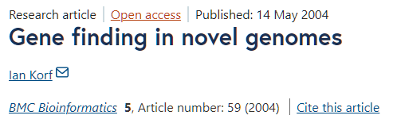
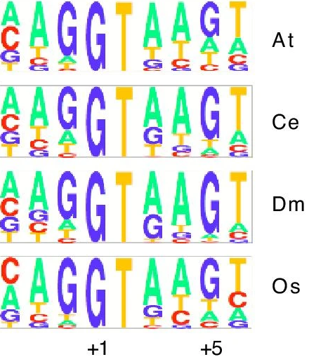
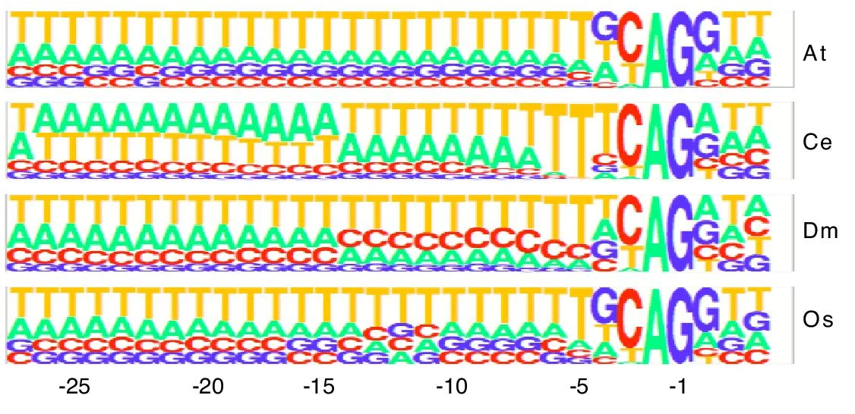
Splice site patterns
Donor (GT)
Acceptor (AG)

Slide 3
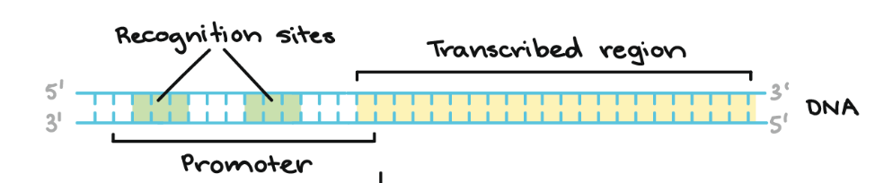
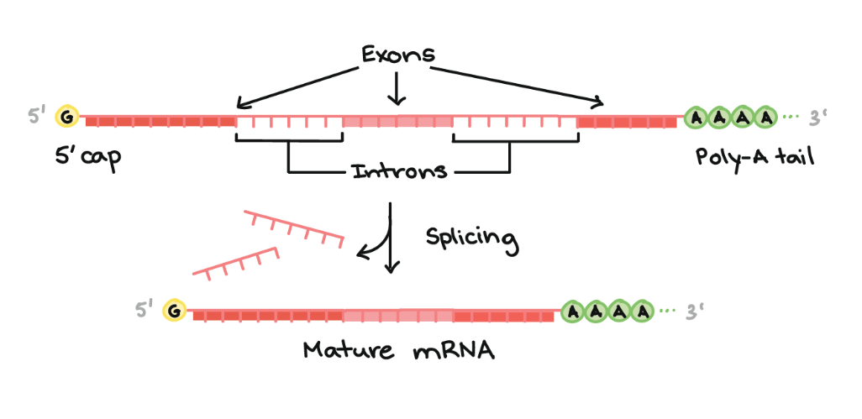
What goes wrong in transcription and translation
Biochemical processes are not exact
RNA polymerase recognizes promoter sites imperfectly
More than 50% of the distinct transcripts are produced in error -- “transcriptional noise”
  Small portion of overall transcripts
  Generally expressed at a low level
  Never coding, recycled in cytoplasm
Introns are sometimes spliced imperfecty
  This is called intron retention
Splicing errors
Image credit: Khan Academy

Slide 4
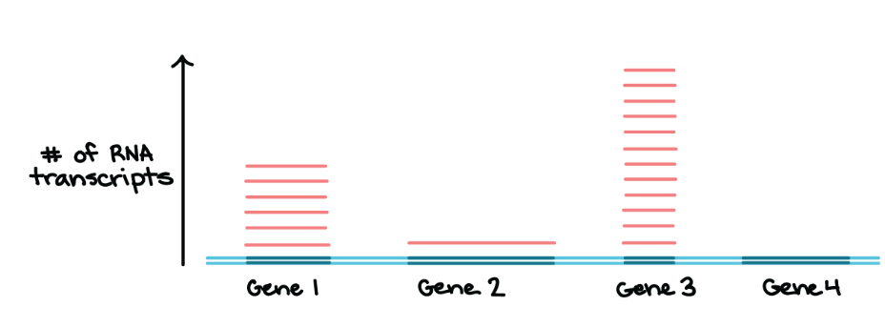
Transcription levels
Transcription levels vary a lot for individual genes
Image credit: Khan Academy

Slide 5
Transcript
Transcripts are sequences of exons after the introns are spliced out:
genome
exon1 exon2 exon3
transcript
exon1 exon2 exon3
UTRs are UnTRanslated sequences before and after the protein coding region
Protein CoDing Sequence (CDS) starts with a start codon (ATG) and ends with a stop (TAG, TAA, or TGA) for eukaryotic genomes
ATG…
…TAA
3’ UTR
3’ UTR
5’ UTR
ATG…
…TAA
3’ UTR
3’ UTR

Slide 6
Gene
Gene is a locus on the genome containing one or more transcripts
Multiple transcripts per gene are possible due to alternative splicing
Gene starts at the start of the leftmost transcript and ends at the end of the rightmost transcript. All transcripts in a gene are on the same strand
Gene 1
intron1
intron2
exon1
GT
AG
exon2
GT
AG
exon3
Transcript 1
intron3
exon1
GT
AG
exon4
Transcript 2

Slide 7
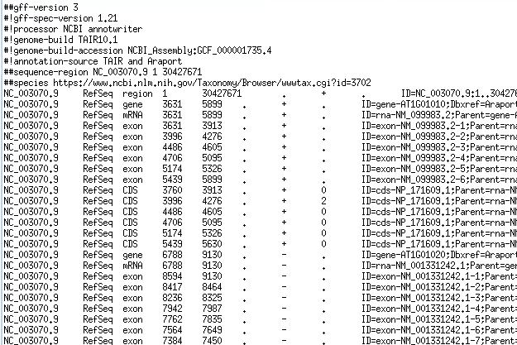
GFF/GTF files provide a map for all known genome features
Column | Description
Seqname | Name of chromosome, scaffold or contig
Source | Name of the data source
Feature | Feature type (e.g. gene, exon, transcript, CDS, five_prime_UTR)
Start | Start position of the feature
End | End position of the feature
Empty | ‘.’
Strand | Defined as + (forward) or - (reverse)
Frame | Either ‘0’, ‘1’, or ‘2’ - indicating reading frame by base position
Attribute | A semicolon separated list of other info about the feature

Slide 8
Gene representation
gene
transcript or mRNA
…
transcript or mRNA
exon
exon
exon
exon
exon
5’ UTR
5’ UTR
5’UTR
CDS
CDS
CDS
3’ UTR
Start codon (ATG)
Stop codon (TAA,TAG,TGA)

